Slide 1
Lecture 24
Simple Linear Regression (continued)

Slide 2
Armand’s Pizza Parlors
Restaurant No. | Student Population (1000s) | Quarterly Sales (1000 Yuan)
1 | 2 | 58
2 | 6 | 105
3 | 8 | 88
4 | 8 | 118
5 | 12 | 117
6 | 16 | 137
7 | 20 | 157
8 | 20 | 169
9 | 22 | 149
10 | 26 | 202

Slide 3
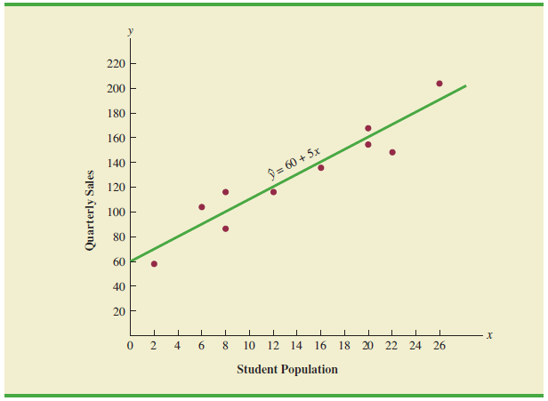
The Least Squares Line

Slide 4
Interpretation of the Regression Coefficients
E(Y|x)=β0+β1x
β0: the expected value of Y when x=0. Sometimes this does not make sense, and we then do not interpret β0.
β1: the increase in the expected value of Y when x is increased by one unit.

Slide 5

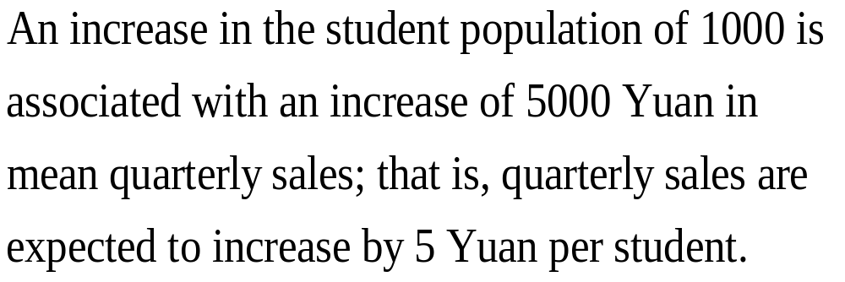

Slide 6
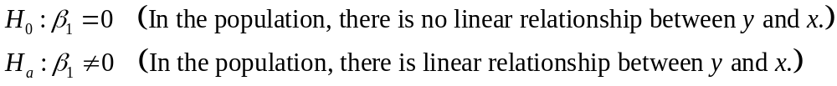
Is model appropriate?
An important step in determining whether the assumed model is appropriate involves testing for the significance of the relationship. E.g.

Slide 7


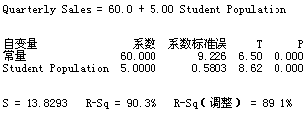
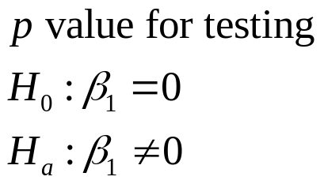
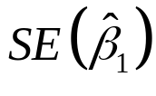
Minitab Results for the Armand Example

Slide 8

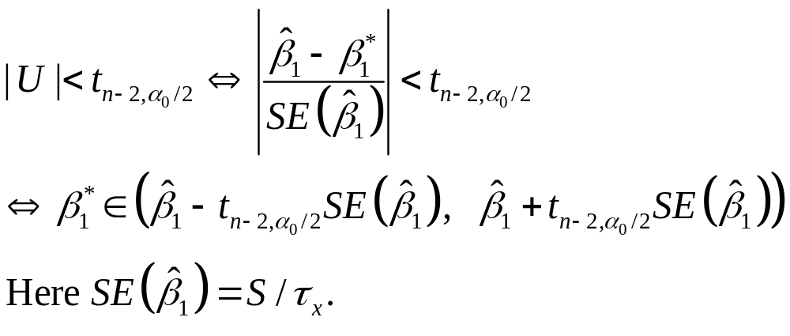
Confidence Interval for β1
The equivalence between hypothesis testing and confidence intervals.
  The set of all values of such that |U|<tn-2, α0/2 (with c0=0 and c1=1) forms a level 1-α0 confidence interval for β1.

Slide 9

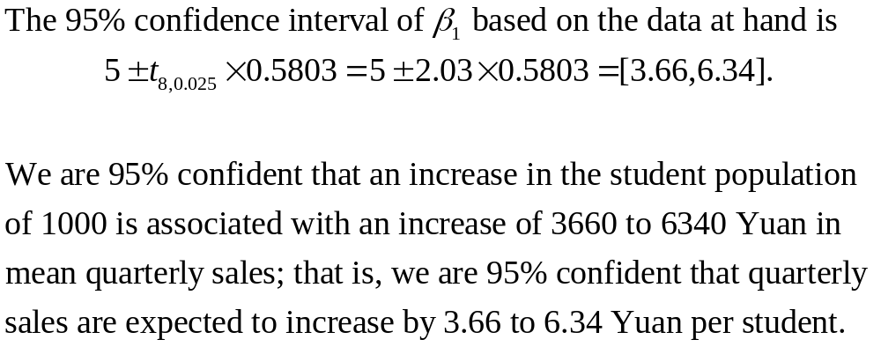
Confidence Interval for in the Armand Example

Slide 10
Question
How well does the estimated regression equation fit the data?

Slide 11
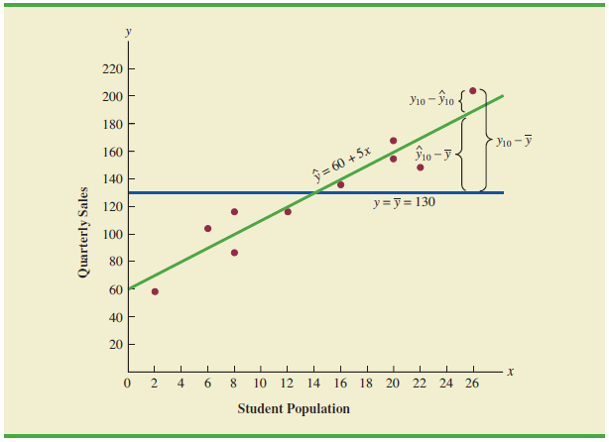
Some Visual Inspection

Slide 12
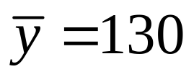
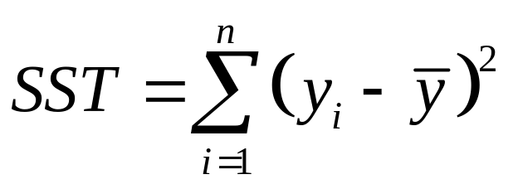
Total Sum of Squares
The sum of squared deviations obtained by using the sample mean to estimate the value of quarterly sales for each restaurant in the sample.
Total sum of squares:

Slide 13
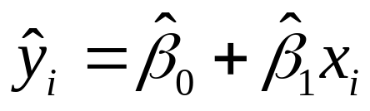
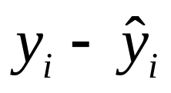
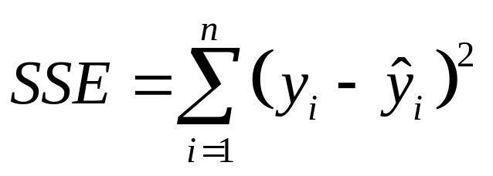
Sum of Squares Due to Error
Let denote the estimated value of the dependent variable using the linear regression model. is called the i th residual (残差).
Sum of squares due to error:

Slide 14


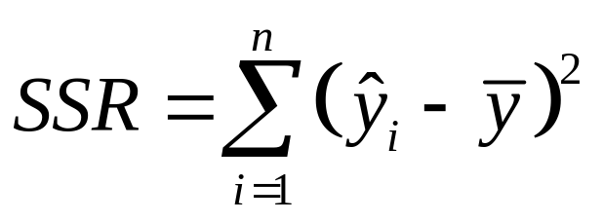
Sum of Squares Due to Regression
Measures how much the values on the estimated regression line deviate from .
Note that the mean of is also .
Sum of squares due to regression:

Slide 15
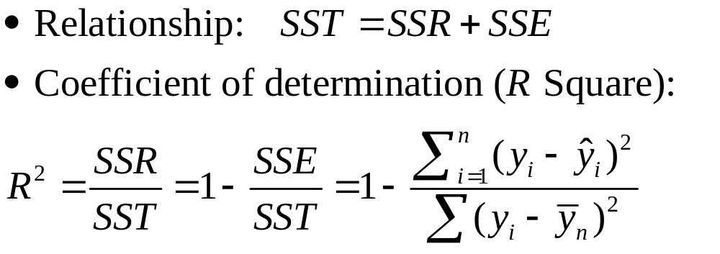
Coefficient of Determination (判决系数)
It is the proportion of variation in Y explained by the using the estimated regression equation.

Slide 16

Minitab Results for the Armand Example

Slide 17
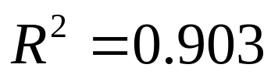
Coefficient of Determination for
The Armand Example
For the Armand example,
So 90.3% of variation in quarterly sales can be explained by using the estimated regression equation.

Slide 18


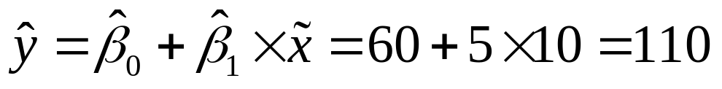
Point Estimation 1
Suppose Armand’s managers want a point estimate
of the mean quarterly sales for all restaurants located near college campuses with 10,000 students ( ), i.e., a point estimate for
A point estimate is
or 110,000 Yuan.

Slide 19

Point Estimation 2
Suppose Armand’s managers want a point estimate of the quarterly sales for an individual restaurant located near a college with 10,000 students ( ), i.e., a point estimate for .
A point estimate is
or 110,000 Yuan.

Slide 20
Interval Estimation 1
Suppose Armand’s managers want an interval estimate of the mean quarterly sales for all restaurants located near college campuses with 10,000 students ( ), i.e., an interval estimate for .
The interval estimate is called a confidence interval.

Slide 21
Interval Estimation 2
Suppose Armand’s managers want an interval estimate of the quarterly sales for an individual restaurant located near a college with 10,000 students ( ), i.e., an interval estimate for .
The interval estimate is called a prediction interval.

Slide 22
Question
Which interval is wider? Confidence interval or prediction interval?

Slide 23
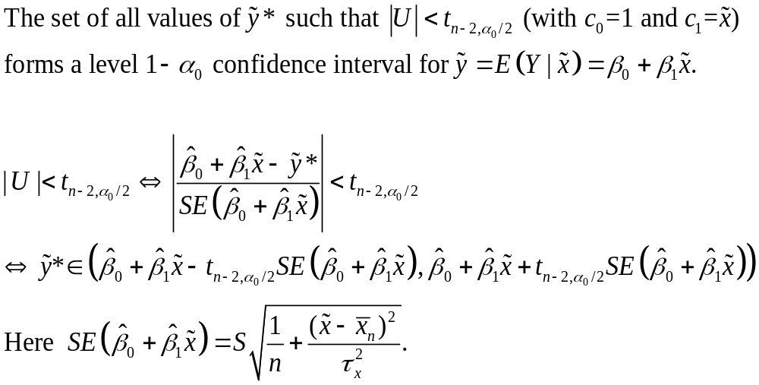
Confidence Interval

Slide 24

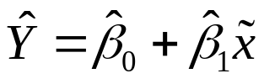
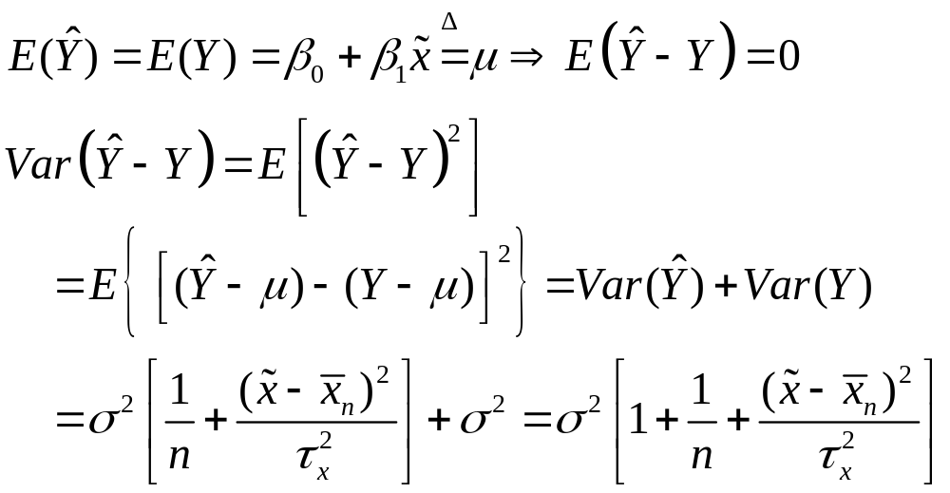
Prediction Interval
Suppose that we want to predict a new Y value, which is independent of the observed data (x1,Y1),…,(xn,Yn), when we knew the corresponding value of .
Point prediction:

Slide 25
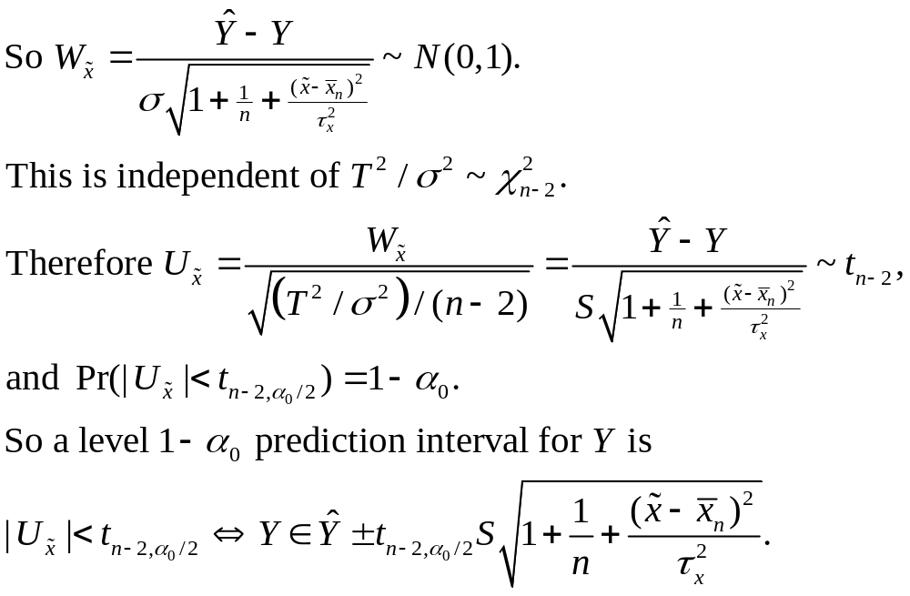
Prediction Interval
(Why?)

Slide 26


Prediction Results from Minitab
新观测值的预测值
新观 拟合值
测值 拟合值 标准误 95% 置信区间 95% 预测区间
1 110.00 4.95 (98.58, 121.42) (76.13, 143.87)
新观测值的自变量值
新观 Student
测值 Population
1 10.0
Confidence Interval
Prediction Interval

Slide 27
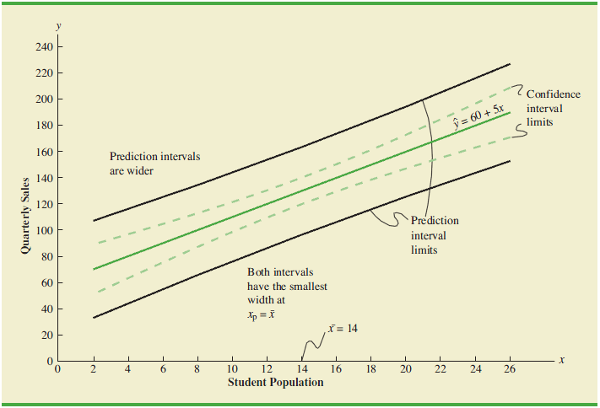
Confidence Interval and Prediction Interval

